Slide 1
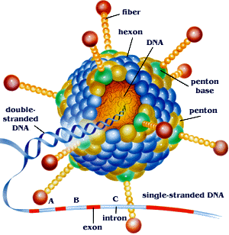
ADENOVIRUSES

Slide 2
Adenoviruses (1953 from adenoids)
Disease: AV cause upper and lower respiratory diseases
Pharyngitis
Conjunctivitis
Common cold & Pneumonia
Keratoconjunctivitis
Hemorrhagic cystitis
Gastroenteritis

Slide 3
Characteristics:
Non-enveloped, double stranded, linear DNA with icosahedral nucleocapsid
Only virus with fiber protruding from each of 12 vertics.
Fiber is toxic to human cells (when purified free from virions)
41 known antigenic types
Fiber protein is main type specific antigen
12, 18 & 31 serotypes of human adenovirus cause sarcomas at site of injection in lab rodents

Slide 4
Replication
Fiber attaches to cells → virus penetrate, uncoat, viral DNA moves to nucleus.
DNA dependent RNA polymerase transcribes early genes
Splicing enzymes remove RNA representing introns
Early mRNA translate → nonstructural Protein in cytoplasm, after viral DNA replication in nucleus
Late mRNA transcribe and then translates→ structural virion protein.
Virus assembly occurs in nucleus,
Virus release by lysis of cell not by budding

Slide 5
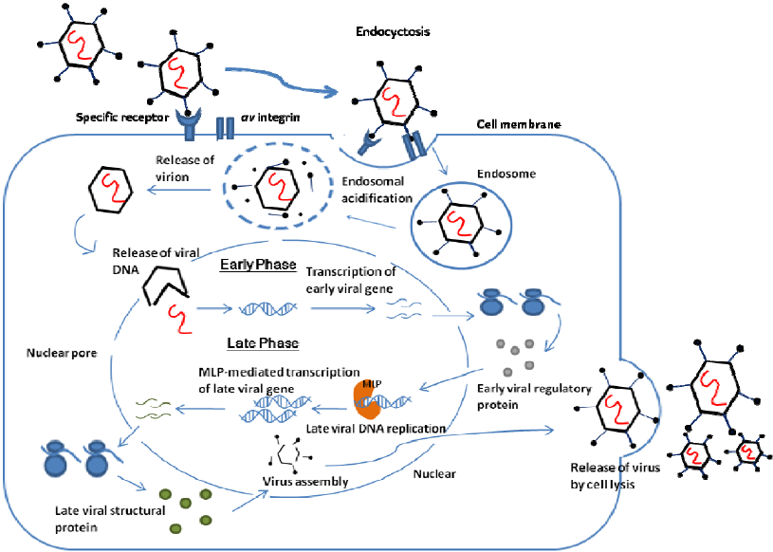

Slide 6
Transmission & epidemiology
Aerosol droplets, fecal-oral route
Disect inoculation of conjuntivas
Endemic worldwide,
Outbreak occurs in military people
Serotypes (3, 4, 7 & 21) cause respiratory disease in military recruits.
Type 8 & 19 cause epidemic keratoconjunctivitis
Type 40 & 41 cause infantile gasteroentritis

Slide 7
Pathogenesis & immunity:
Adenovirus infect → mucosal epithelium
Respiratory tract
Gasterointestinal tract
Conjunctivitis
Immunity based on neutralizing Ab → type specific and lifelong
In acute infection, after cell death, virus cause latent infection in Adenoidal and tonsillar tissue of throat

Slide 8
Clinical findings
In upper respiratory tract: Pharyngitis, pharyngoconjunctival fever, acute res.disease with fever, sore throat, Coryza.
In lower respiratory tract: Bronchitis, atypical Pneumonia,
Gasterenteritis with non bloody diarrhea occurs mainly in children younger than 2 years of age.
Approx. ½ of all AV infections are asymptomatic.

Slide 9
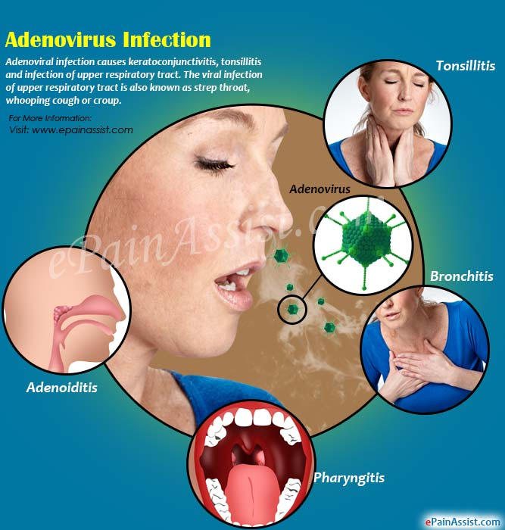

Slide 10
Diagnosis:
Isolation of virus in cell culture and detection of 4 fold rise in Ab titer
Serologic tests base on complement fixation and hemmaglutination are mostly used
Treatment:
No Antiviral treatment

Slide 11
Prevention:
3 live, non-attenuated vaccine against serotypes 4, 7 & 21 are available but used only for military (not for civilian use)
Each of 3 vaccines are monovalent.
Viruses are administered separately because they interfere with each other when given together.
Vaccines are delivered in an enteric coated capsule to protect live virus from inactivation by stomach acid.

